Slide 1
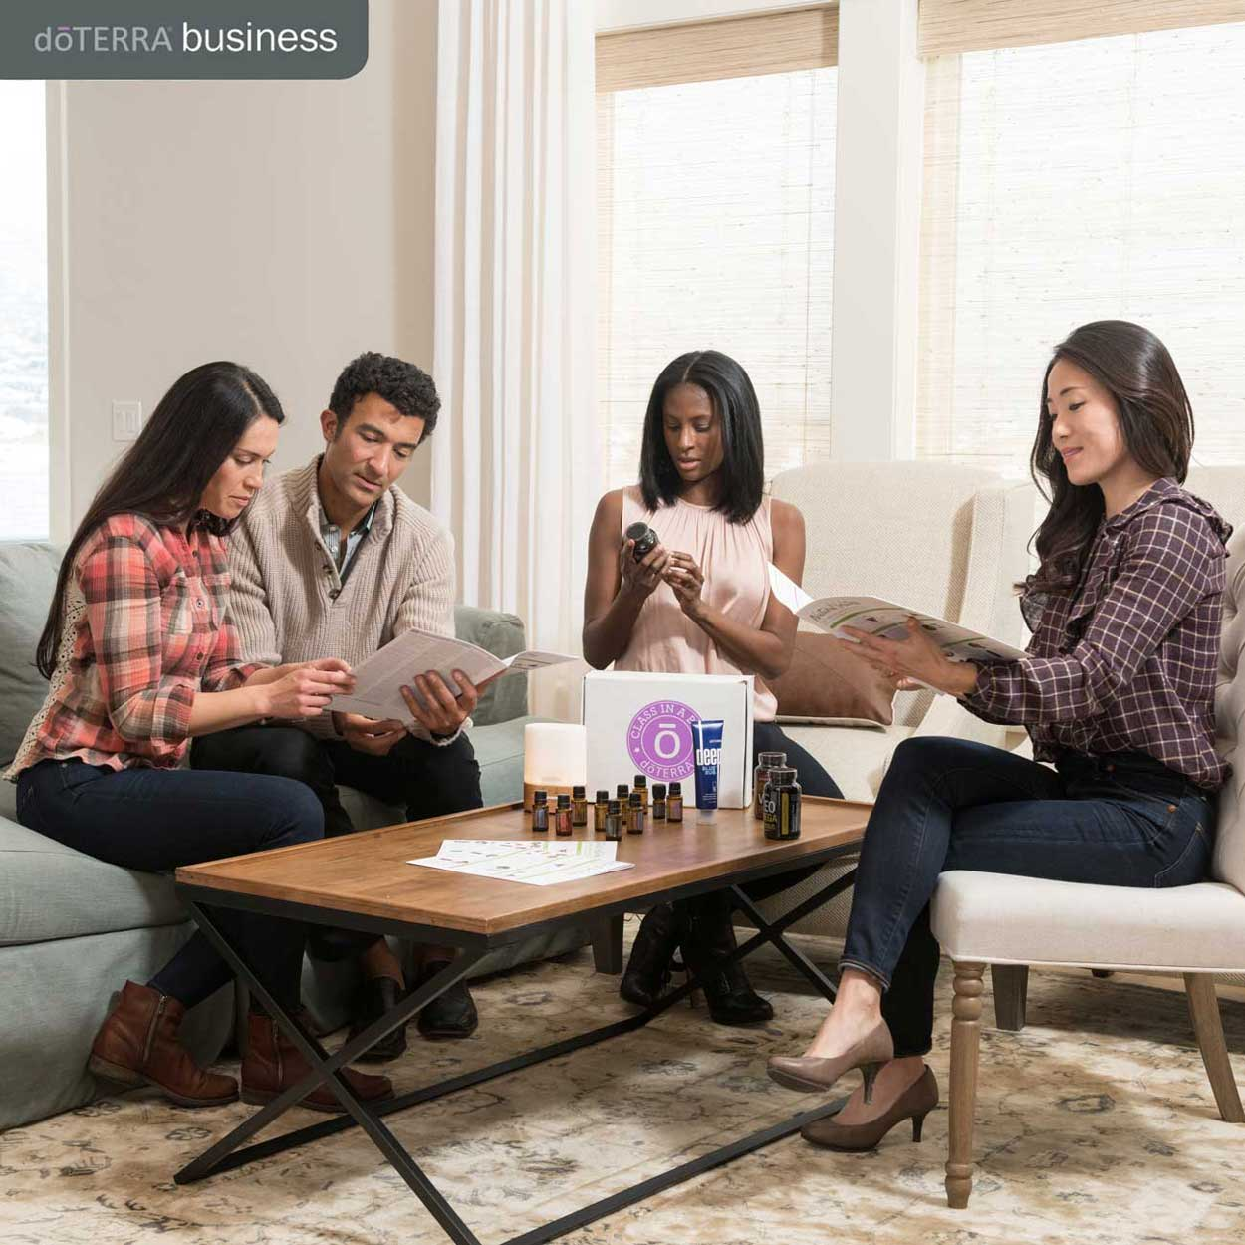
Notes:
Your doTERRA Membership comes with a lot of perks, so I want to be sure to explain them to you so you get the most benefit from your Membership.

Slide 2
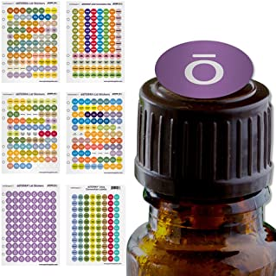
1
Unpack your order
2
Put stickers on the top of your oils
Notes:
First, let’s unpack your order! Open up those Oils and smell them! Decide where to put them so you will be most likely to use them. I like to put them in front of or where I would typically keep OTC remedies.
Be sure to put your stickers on them, so you can pick them out easily!

Slide 3
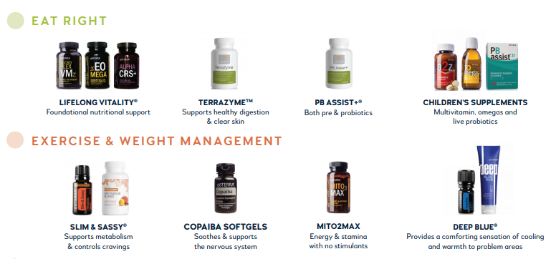
3
Let’s narrow down the best place to start.
Number the categories on this page and the next 1-4.
1 is what you want to focus on first in your wellness journey.
Notes:
On these next two pages, there are 4 Categories that you will find on your handout or can jot down if you don’t have a handout. I want you to number these from 1-4 with #1 being the one you want to focus on first in your Wellness Journey. Then we can discuss the products in the category that is your top priority.

Slide 4
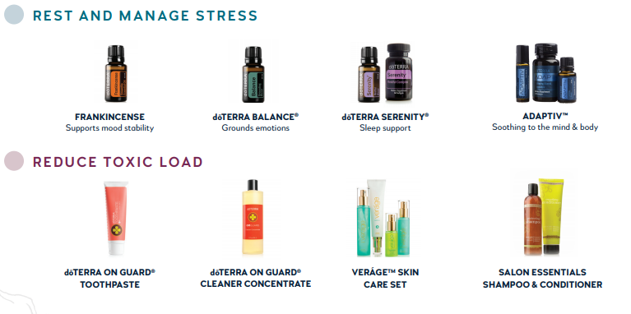
Notes:
Ok, now that you have prioritized your needs, we will go over those products and you can ask me about any other items in the other categories that particularly interest you.

Slide 5
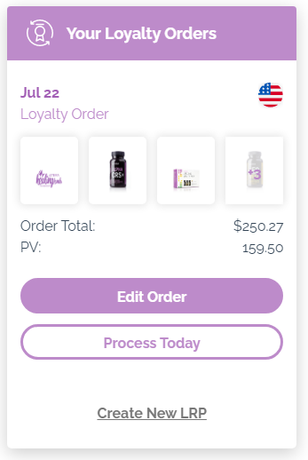
The best way to order
Notes:
There are a few simple tips to getting the most out of your membership. The first is that the best way to order is through our Loyalty Rewards Program – this is how you will be able to get FREE Oils! I’ll be explaining more about that, but first, write in (or jot down) your doTERRA.com Login (ID#) and write in (or jot down) your Password.

Slide 6
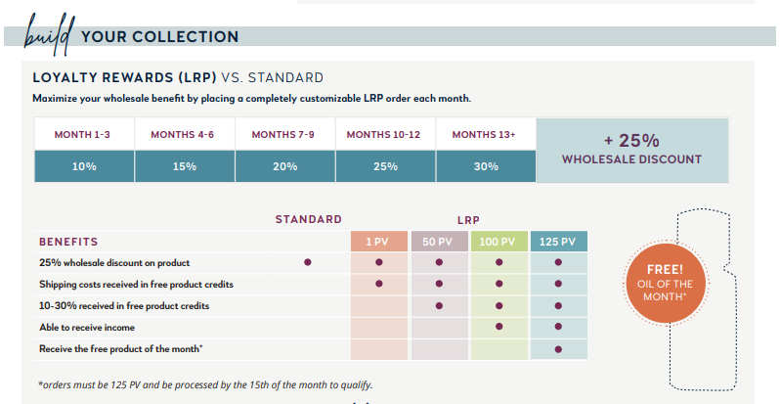
Notes:
This is how to build your doTERRA Collection through maximizing your benefits. The Loyalty Rewards Program allows you to place a Monthly Order that you can change each month to suit your needs. Anytime you have an order of 50 PV (Approx. $50 in products) or more, you receive FREE Product Points. For the first 3 mos. You receive 10% back in FREE Products. Then they reward you further by giving you 15% back, on up to 30%. If you order between 1+49 PV, it’s like putting your Loyalty Account on Pause. You don’t lose or gain points.

Slide 7
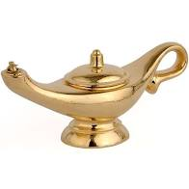
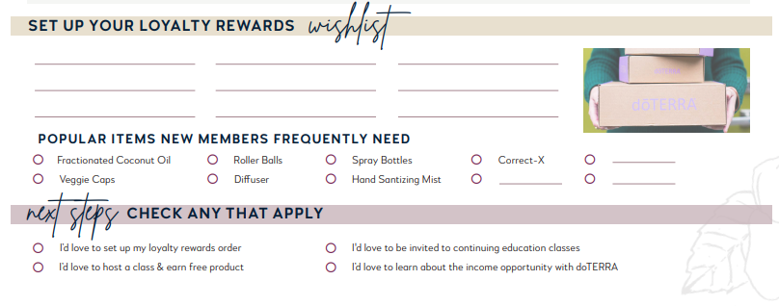
Your Wishlist
Notes:
This is your Wishlist, so let’s look at your Priorities and have you list 3 items from #1 in the first column, 3 from #2 in the 2nd Column, and 3 from #3 in the 3rd column. Then check off any of the Popular Items that appeal to you.
Next, check off if you’d like to set up your LRP Order, Host a Class to earn FREE Products, be invited to Continuing Ed Classes, or learn about earning a Supplemental or Replacement Income with doTERRA.

Slide 8
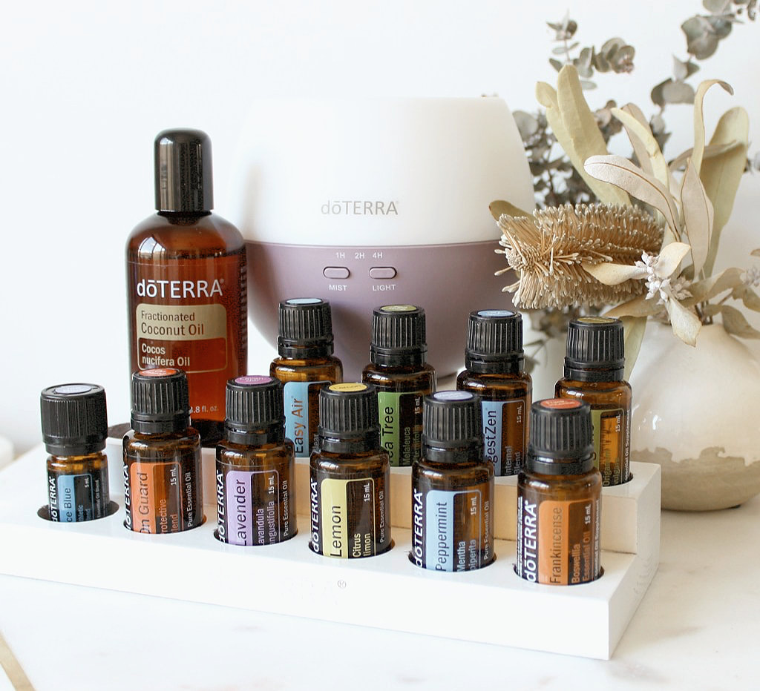
We hope you’ve enjoyed this presentation of
We look forward to
supporting you further on your Wellness Journey!
Notes:
We hope you’ve enjoyed this presentation of Your Membership Made Easy! We look forward to supporting you further on your Wellness Journey! Thank you all for coming. At this point, please take a snapshot of your Membership Made Easy Handout pages and send them to the person who invited you.

